Slide 1
IOT UL Mobile Workshop
By Thomas Flynn

Slide 2
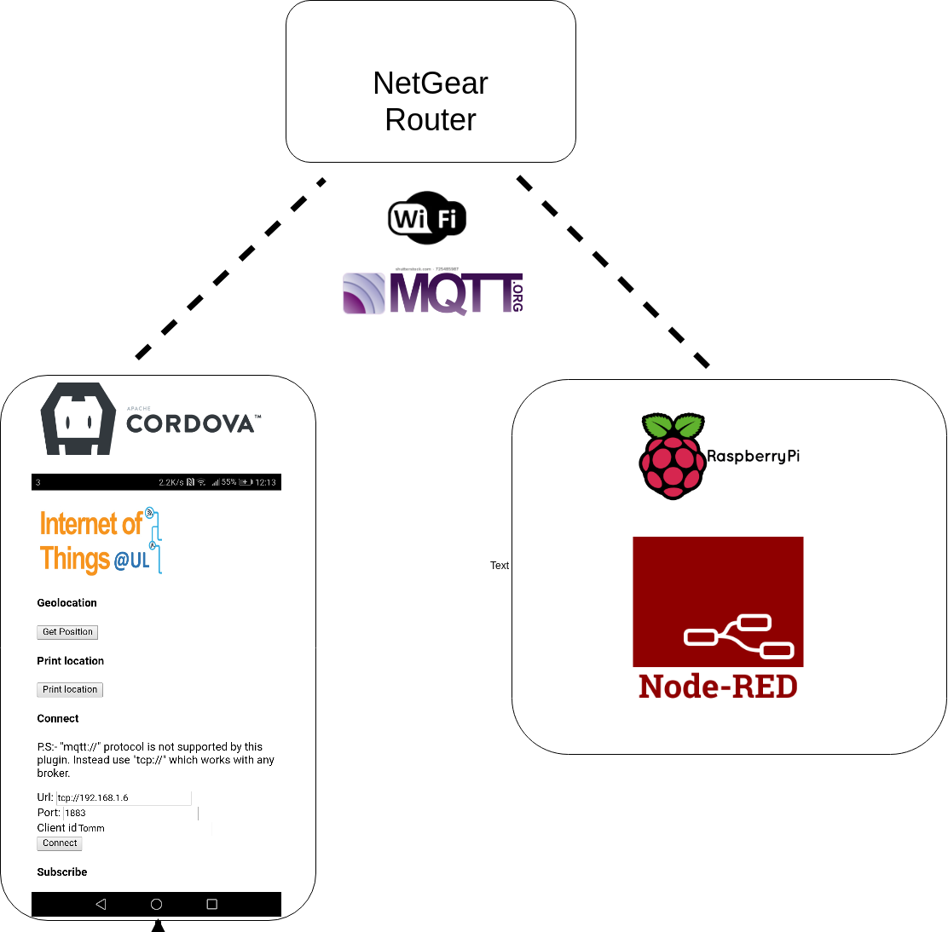
Workshop Objective

Slide 3
Hybrid vs Native vs Web Apps
A mobile application, most commonly referred to as an app, is a type of
application software designed to run on a mobile device, such as a smartphone or tablet.
Three different approaches for developing a mobile application.
Mobile Web Apps
Hybrid Apps
Native Apps

Slide 4
Mobile Web Apps
Accessed through mobile device’s web browser.
Built with three core technologies:
HTML4/5 (defines static text and Images)
CSS2/3 (defines styles and presentation)
JavaScript ( defines Interactions and animations).
Since web apps are browser based they’re intend to be platform and device independent.
Simple and easy to access.

Slide 5
Native Apps
Built for a particular device and its operatingsystems.
Downloaded from a web store and installed on the device.
Native apps are written in Java for Android, Objective-C for Apple iOS.
Native apps examples :
Native Calendar Apps
Native SMS Apps
Native Game Apps
Native Push Notifications
Native To do list

Slide 6
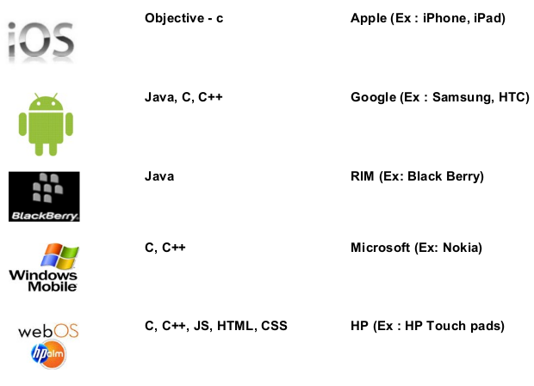
Native Apps - Platforms /Operating Systems

Slide 7
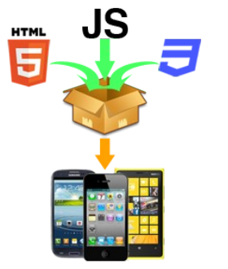
Hybrid Apps
Hybrid apps, like native apps, run on the device, and are written with web technologies (HTML5, CSS and JavaScript).
Hybrid apps run inside a native container, and leverage the device’s browser engine (but not the browser) to render the HTML and process the JavaScript locally.
Remarks:
• Can’t handle heavy graphics
• Requires familiarity with a mobile framework
• You cannot access all hardware functions of mobile devices

Slide 8
HTML
Hypertext Markup Language (HTML) is the standard markup language for creating web pages and web applications. With Cascading Style Sheets (CSS) and JavaScript, it forms a triad of cornerstone technologies for the World Wide Web.
Web browsers receive HTML documents from a web server or from local storage and render the documents into multimedia web pages. HTML describes the structure of a web page semantically and originally included cues for the appearance of the document.
HTML elements are the building blocks of HTML pages. With HTML constructs, images and other objects such as interactive forms may be embedded into the rendered page

Slide 9
HTML
All HTML documents must start with a document type declaration: <!DOCTYPE html>.
The HTML document itself begins with <html> and ends with </html>.
The visible part of the HTML document is between <body> and </body>.
HTML headings are defined with the <h1> to <h6> tags.
HTML paragraphs are defined with the <p> tag:
HTML buttons are defined with the <button> tag:

Slide 10
CSS
Styling HTML with CSS
CSS stands for Cascading Style Sheets.
CSS describes how HTML elements are to be displayed on screen, paper, or in other media.
CSS saves a lot of work. It can control the layout of multiple web pages all at once.
CSS can be added to HTML elements in 3 ways:
Inline - by using the style attribute in HTML elements
Internal - by using a <style> element in the <head> section
External - by using an external CSS file

Slide 11

Javascript
Alongside HTML and CSS, JavaScript is one of the three core technologies of the World Wide Web.
JavaScript enables interactive web pages and thus is an essential part of web applications. The vast majority of websites use it, and all major web browsers have a dedicated JavaScript engine to execute it.
JavaScript engines are now embedded in many other types of host software, including server-side in web servers and databases, and in runtime environments that make JavaScript available for writing mobile and desktop applications, including desktop widgets.
Although there are strong outward similarities between JavaScript and Java, including language name, syntax, and respective standard libraries, the two languages are distinct and differ greatly in design; JavaScript was influenced by programming languages such as Self and Scheme.

Slide 12
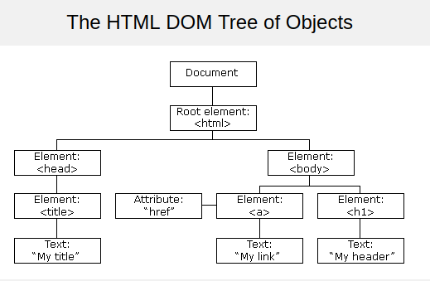
The HTML DOM (Document Object Model)
When a web page is loaded, the browser creates a Document Object Model of the page.
The HTML DOM model is constructed as a tree of Objects:
It is a standard object model and programming interface for HTML.
It defines:
The HTML elements as objects
The properties of all HTML elements
The methods to access all HTML elements
The events for all HTML elements
In other words:
The HTML DOM is a standard for how to get, change, add, or delete HTML elements.

Slide 13
The HTML <script> Tag
The <script> tag is used to define a client-side script (JavaScript).
The <script> element either contains scripting statements, or it points to an external script file through the src attribute.
Common uses for JavaScript are image manipulation, form validation, and dynamic changes of content.
To select an HTML element, JavaScript very often uses the document.getElementById() method.
This JavaScript example writes "Hello JavaScript!" into an HTML element with id="demo":
<script>
document.getElementById("demo").innerHTML = "Hello JavaScript!";
</script>

Slide 14
HTML DOM addEventListener() Method
Definition and Usage
The document.addEventListener() method attaches an event handler to the document.
Tip: Use the element.addEventListener() method to attach an event handler to a specified element.
Example
document.addEventListener("click", function(){
document.getElementById("demo").innerHTML = "Hello World";
});

Slide 15

Crash course finished!

Slide 16
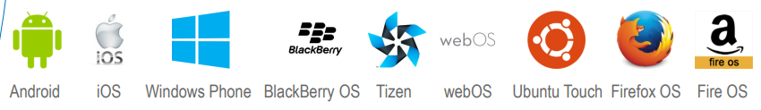
Apache Cardova
Apache Cordova is an open-source mobile application framework.
It allows you to use standard web technologies such as HTML5, CSS3, and JavaScript for cross-platform development, avoiding each mobile platforms' native development language.
Applications execute within wrappers targeted to each platform.

Slide 17
Apache Cordova
BUILDING CROSS-PLATFORM APPS USING WEB TECHNOLOGIES
Even before the Mobile era, developers that want to target more than one Platform/OS would like their framework to be: Write Once Run Anywhere
Examples:
C is a WORA language the application can be written without taking into account the underlying hardware.
Java is a WORA framework you can write desktop applications without taking into account the underlying OS
Cordova is a WORA framework for mobile you can write mobile applications without taking into account the underlying Mobile OS

Slide 18
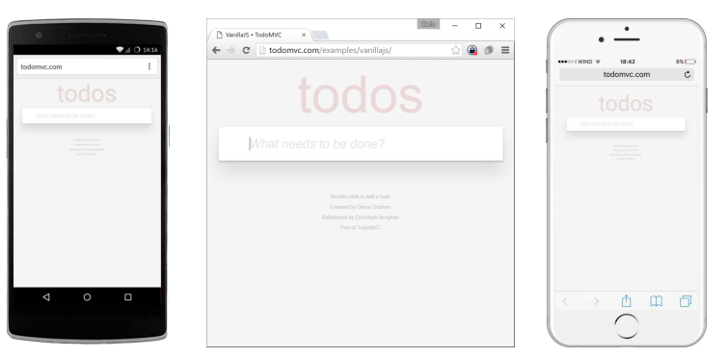
The Idea
Every smartphone has a browser
Mobile browsers are becoming more and more powerful.
Every mobile OS has a native UI component that allows one to integrate a web browser inside an application (WebView).
If our application is built with standard web technologies we just need to pack it inside a native application that loads it into a full screen browser.

Slide 19
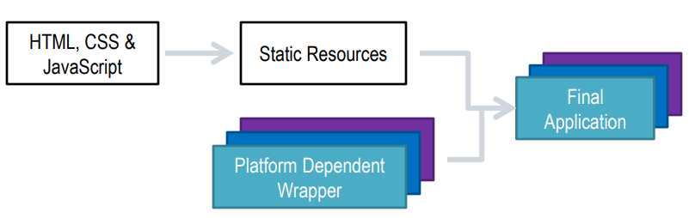
How is The Application Built?
The application is developed in HTML, CSS and JavaScript.
The generated files are packed as static resources of a wrapper application.
This application takes care of initializing a WebView and loading the home page.

Slide 20
Application lifecycle
If your application behaves as a classic website you do not need to take the lifecycle into account.
Your application will be automatically loaded, paused, resumed and closed by the system.
If your application requires to react to lifecycle’s events (e.g. initialize at application launch, save data at application pause, refresh at application resume, …)
Wrappers expose standard and platform independent events that can be used to react accordingly.

Slide 21
Events
Here is a list of the most common events exposed to the application:
Device Ready (The application is fully loaded)
Application Pause (The application is going to be paused)
Application Resume (The application has been resumed)
Back Button Pressed
Menu Button Pressed
Search Button Pressed
Start Call Button Pressed
End Call Button Pressed
Volume Down Button Pressed
Volume Up Button Pressed

Slide 22
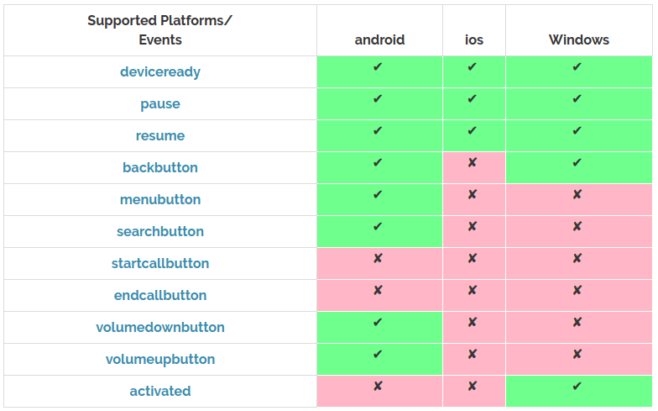
Cordova Events and Supported Platforms

Slide 23
Device Ready
The deviceready event signals that Cordova's device APIs have loaded and are ready to access.
Cordova consists of two code bases: native and JavaScript.
While the native code loads, a custom loading image displays. However, JavaScript only loads once the DOM loads.
This means the web app may potentially call a Cordova JavaScript function before the corresponding native code becomes available.
The deviceready event fires once Cordova has fully loaded.
Once the event fires, you can safely make calls to Cordova APIs.
Example code
document.addEventListener("deviceready", onDeviceReady, false); function onDeviceReady() { // Now safe to use device APIs }

Slide 24
Config.xml
Config.xml is a global configuration file that controls many aspects of a cordova application's behavior. This platform-agnostic XML file is arranged based on the W3C's Packaged Web Apps (Widgets)specification, and extended to specify core Cordova API features, plugins, and platform-specific settings.
For projects created with the Cordova CLI (described in The Command-Line Interface), this file can be found in the top-level directory:
app/config.xml

Slide 25
Plugins
A plugin is a package of injected code that allows the Cordova webview within which the app renders to communicate with the native platform on which it runs.
Plugins provide access to device and platform functionality that is ordinarily unavailable to web-based apps.
Plugins comprise a single JavaScript interface along with corresponding native code libraries for each supported platform. In essence this hides the various native code implementations behind a common JavaScript interface.
Application developers use the CLI's plugin add command to add a plugin to a project. The argument to that command is the URL for a git repository containing the plugin code.
This example implements Cordova's Device API:
cordova plugin add https://git-wip-us.apache.org/repos/asf/cordova-plugin-device.git

Slide 26
Cordova Architecture
WebView
The Cordova-enabled WebView may provide the application with its entire user interface. On some platforms, it can also be a component within a larger, hybrid application that mixes the WebView with native application components. (See Embedding WebViews for details.)
Web App
This is the part where your application code resides. The application itself is implemented as a web page, by default a local file named index.html, that references CSS, JavaScript, images, media files, or other resources are necessary for it to run. The app executes in a WebView within the native application wrapper, which you distribute to app stores.
This container has a very crucial file - config.xml file that provides information about the app and specifies parameters affecting how it works, such as whether it responds to orientation shifts.

Slide 27
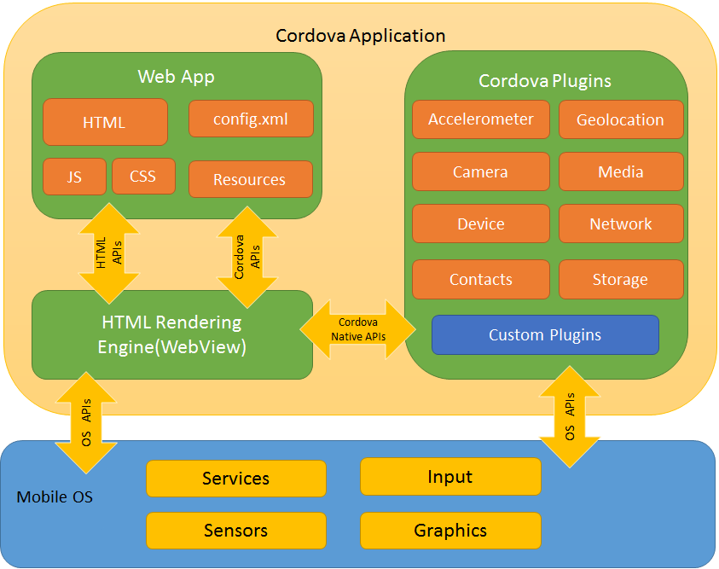
Cordova Architecture

Slide 28
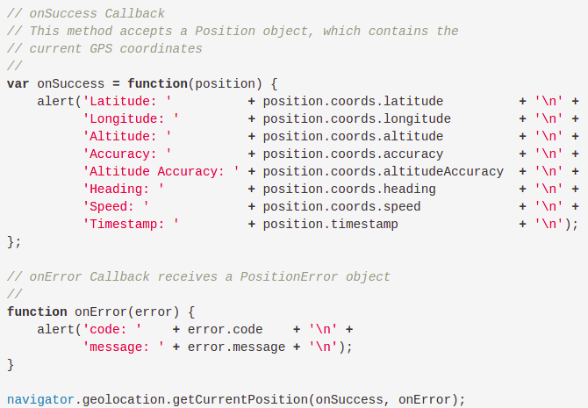
Geolocation plugin
This plugin provides information about the device's location, such as latitude and longitude.

Slide 29

Javascript Syntax

